Slide 1


(Normal) Grain Growth
27-750
Texture, Microstructure & Anisotropy
A.D. Rollett
Updated 5th Apr. 2014

Slide 2
References
Recrystallization & Related Annealing Phenomena, F.J. Humphreys, Elsevier, 2nd Ed., 2004.
Papers noted in individual slides.

Slide 3
Outline
Re-cap of Herring relations at triple lines
The “n-6 rule”
Integration of turning angle around a grain
Test of the n-6 rule
Stability of 2D networks
Grain growth, self-similarity
Grain growth, basic theory
Grain growth exponent
Coarsening theory, Hillert model
Grain size distributions
Full equation for migration rate of a boundary

Slide 4
Interfacial Energies
Practical Applications: Rain-X for windshields. Alters the water/glass:glass/vapor ratio so that the contact angle is increased. Water droplets “bead up” on the surface.
“streaky” “clear”

Slide 5
Impact on Materials
Surface grooving where grain boundaries intersect free surfaces leads to surface roughness, possibly break-up of thin films.
Excess free energy of interfaces (virtually all circumstances) implies a driving force for reduction in total surface area, e.g. grain growth (but not recrystallization).
Interfacial Excess Free Energy:= γ, or σ

Slide 6
Force Balance
Consider only interfacial energy: vector sum of the forces must be zero to satisfy equilibrium.
These equations can be rearranged to give the Young equations (sine law):

Slide 7
Dihedral Angles from Energies
If the energies of the 3 boundaries are known, it is simple to compute the dihedral angles.
Example for one angle shown: others obtained by permutation.

Slide 8
Herring’s Relations
C. Herring in The Physics of Powder Metallurgy. (McGraw Hill, New York, 1951) pp. 143-79

Slide 9
Expanded Young Equations
Project the force balance along each grain boundary normal in turn, so as to eliminate one tangent term at a time:

Slide 10
Why Triple Junctions?
For isotropic g.b. energy, 4-fold junctions split into two 3-fold junctions with a reduction in free energy:
90°
120°

Slide 11
The “n-6 Rule”
The “n-6 rule” is the rule previously shown pictorially that predicts the growth or shrinkage of grains (in 2D only) based solely on their number of sides/edges. For n>6, grain grows; for n<6, grain shrinks.
Originally derived for gas bubbles by von Neumann (1948) and written up as a discussion on a paper by Cyril Stanley Smith (W.W. Mullins’ advisor).

Slide 12
Curvature and Sides on a Grain
Shrinkage/growth depends on which way the grain boundaries migrate, which in turn depends on their curvature.
velocity = mobility * driving force; driving force = g.b. stiffness * curvature v = Mf = M (γ+ γ”) κ
We can integrate the curvature around the perimeter of a grain in order to obtain the net change in area of the grain.

Slide 13
Integrating inclination angle to obtain curvature
Curvature = rate of change of tangent with arc length, s: κ = dφ/ds
Integrate around the perimeter (isolated grain with no triple junctions), k= M γ :

Slide 14
Effect of TJs on curvature
Each TJ in effect subtracts a finite angle from the total turning angle to complete the perimeter of a grain:
3
1
φ₁−φ₃
2

Slide 15
Isotropic Case
In the isotropic case, the turning angle (change in inclination angle) is 60°.
For the average grain with <n>=6, the sum of the turning angles = <n>60°=6*60° =360°.
Therefore all the change in direction of the perimeter of an n=6 grain is accommodated by the dihedral angles at the TJs, which means no change in area.

Slide 16
Isotropy, n<6, n>6
If the number of TJs is less than 6, then not all the change in angle is accommodated by the TJs and the GBs linking the TJs must be curved such that their centers of curvature lie inside the grain, i.e. shrinkage
If n>6, converse occurs and centers of curvature lie outside the grain, i.e. growth.
Final result: dA/dt = πk/6(n-6) , k= M γ
Known as the von Neumann-Mullins Law.
von Neumann, J. (1952). discussion of article by C.S. Smith. Metal Interfaces, Cleveland, Amer. Soc. Testing of Materials.
Mullins, W. W. (1956). "Two-dimensional motion of idealized grain boundaries." Journal of Applied Physics 27 900-904.

Slide 17
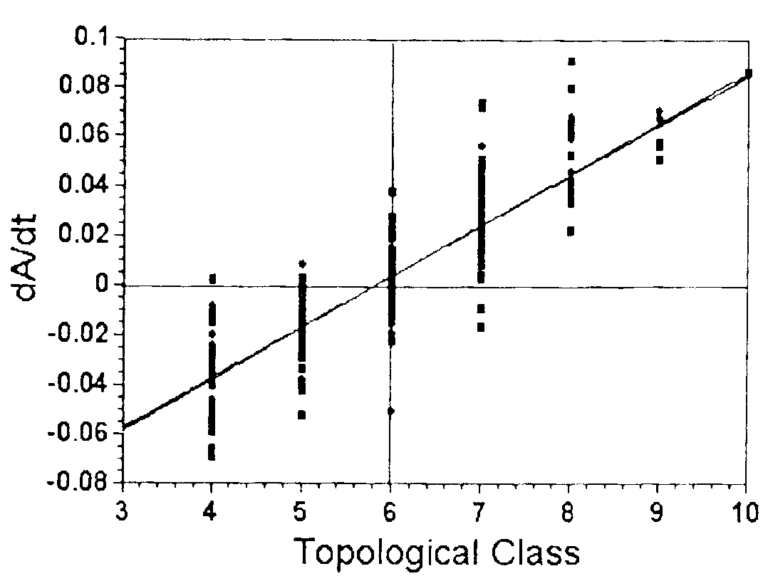
Test of the n-6 Rule
Grain growth experiments in a thin film of 2D polycrystalline succinonitrile (bcc organic, much used for solidification studies) were analyzed by Palmer et al.
Averaging the rate of change of area in each size class produced an excellent fit to the (n-6) rule.
Scripta metall. 30, 633-637 (1994).
Note the scatter in dA/dt within each topological class; this indicates that the local neighborhood of each grain has an effect on its growth.

Slide 18
Stability of 2D Networks
Note that a precisely hexagonal network of grain boundaries is metastable (not stable as stated in the caption). Any perturbation will set up a net driving force for a grain smaller than the average to shrink.
Humphreys

Slide 19
Grain Growth
One interesting feature of grain growth is that, in a given material subjected to annealing at the same temperature, the only difference between the various microstructures is the average grain size. Or, expressed another way, the microstructures (limited to the description of the boundary network) are self-similar and cannot be distinguished from one another unless the magnification is known. This characteristic of grain growth has been shown by Mullins (1986) to be related to the kinetics of grain growth. The kinetics of grain growth can be deduced in a very simple manner based on the available driving force.
Curvature is present in essentially all grain boundary networks and statistical self-similarity in structure is observed both in experiment and simulation. This latter observation is extremely useful because it permits an assumption to be made that the average curvature in a network is inversely proportional to the grain size. In other words, provided that self-similarity and isotropy hold, the driving force for grain boundary migration is inversely proportional to grain size.
Mullins, W. (1986). "The statistical self-similarity hypothesis in grain growth and particle coarsening." Journal of Applied Physics 59 1341.

Slide 20
Self-Similarity
Humphreys

Slide 21
Grain Growth Kinetics
The rate of change of the mean size, d<r>/dt, must be related to the migration rate of boundaries in the system. Thus we have a mechanism for grain coarsening (grain growth) and a quantitative relationship to a single measure of the microstructure. This allows us to write the following equations. v = α M γ / r = d<r>/dt One can then integrate and obtain
<r>² - <r_{t=0}>²= α M γ t
In this, the constant α is geometrical factor of order unity (to be discussed later). In Hillert’s theory, α = 0.25. From simulations, α ~ 0.40.
Burke, J. E. (1949). "Some Factors Affecting the Rate of Grain Growth in Metals." Trans. AIME 180: 73-91.

Slide 22
Grain Growth Exponent
Humphreys

Slide 23
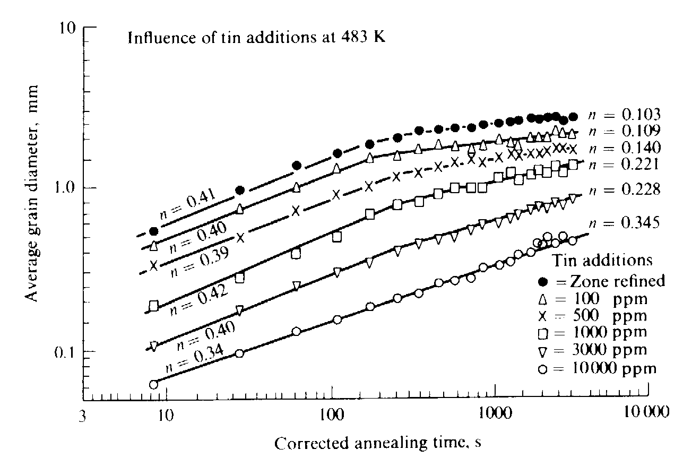
Experimental grain growth data
Data from Grey & Higgins (1973) for zone-refined Pb with Sn additions, showing deviations from the ideal grain growth law (n<0.5).
In general, the grain growth exponent (in terms of radius) is often appreciably less than the theoretical value of 0.5

Slide 24
Grain Growth Theory
The main objective in grain growth theory is to be able to describe both the coarsening rate and the grain size distribution with (mathematical) functions.
What is the answer? Unfortunately only a partial answer exists and it is not obvious that a unique answer is available, especially if realistic (anisotropic) boundary properties are included.
Hillert (1965) adapted particle coarsening theory by Lifshitz-Slyozov and Wagner [Scripta metall. 13, 227-238].
Lifshitz, I. M. and V. V. Slyozov (1961). "The Kinetics of Precipitation from Supersaturated Solid Solutions." Journal Of Physics And Chemistry Of Solids 19 35-50. Wagner, C. (1961). "Theorie Der Alterung Von Niederschlagen Durch Umlosen (Ostwald-Reifung)." Zeitschrift Fur Elektrochemie 65 581-591.

Slide 25
Hillert Normal Grain Growth Theory
Coarsening rate: <r>² - <r_{t=0}>² = 0.25 k t = 0.25 Mγ t
Grain size distribution (2D), f: Here, ρ = r/<r>, also known as the reduced grain size.

Slide 26
Hillert Normal Grain Growth Theory
Grain size distribution (3D), f: Here, ρ = r/<r>.
General formula:

Slide 27
Grain Size Distributions
Humphreys
a) Comparison of theoretical distributions due to Hillert (dotted line), Louat (dashed) and the log-normal (solid) distribution. The histogram is taken from the 2D computer simulations of Anderson, Srolovitz et al. b) Histogram showing the same computer simulation results compared with experimental distributions for Al (solid line) by Beck and MgO (dashed) by Aboav and Langdon.
Later lecture: we will see in a subsequent lecture that grain size distributions are best characterized with probability plots.

Slide 28
Development of Hillert Theory
Where does the solution come from?
The most basic aspect of any particle coarsening theory is that it must satisfy the continuity requirement, which simply says that the (time) rate of change of the number of particles of a given size is the difference between the numbers leaving and entering that size class.
The number entering is the number fraction (density), f, in the class below times the rate of increase, v. Similarly for the size class above. ∂f/∂t = ∂/∂r(fv)

Slide 29
Grain Growth Theory (1)
Expanding the continuity requirement gives the following:
Assuming that a time-invariant (quasi-stationary) solution is possible, and transforming the equation into terms of the relative size, ρ:
Clearly, all that is needed is an equation for the distribution, f, and the velocity of grains, v.

Slide 30
Grain Growth Theory (2)
General theories also must satisfy volume conservation:
In this case, the assumption of self-similarity allows us to assume a solution for the distribution function in terms of ρ only (and not time).

Slide 31
Grain Growth Theory (3)
A critical part of the Hillert theory is the link between the n-6 rule and the assumed relationship between the rate of change, v=dr/dt.
N-6 rule: dr/dt = Mγ(π/3r)(n-6)
Hillert: dr/dt = Mγ /2{1/<r>-1/r} = Mγ /2<r> {ρ - 1}
Note that Hillert’s (critical) assumption means that there is a linear relationship between size and the number of sides: n = 6{1 +0.5 (r/<r> - 1)} =3 {1 + ρ}

Slide 32
Anisotropic grain boundary energy
If the energies are not isotropic, the dihedral angles vary with the nature of the g.b.s making up each TJ.
Changes in dihedral angle affect the turning angle.
See: Rollett and Mullins (1996). “On the growth of abnormal grains.” Scripta metall. et mater. 36(9): 975-980. An explanation of this theory is given in the second section of this set of slides.

Slide 33
v = Mf, revisited
If the g.b. energy is inclination dependent, then equation is modified: g.b. energy term includes the second derivative. Derivative evaluated along directions of principal curvature.
• Care required: curvatures have sign; sign of velocity depends on convention for normal.

Slide 34
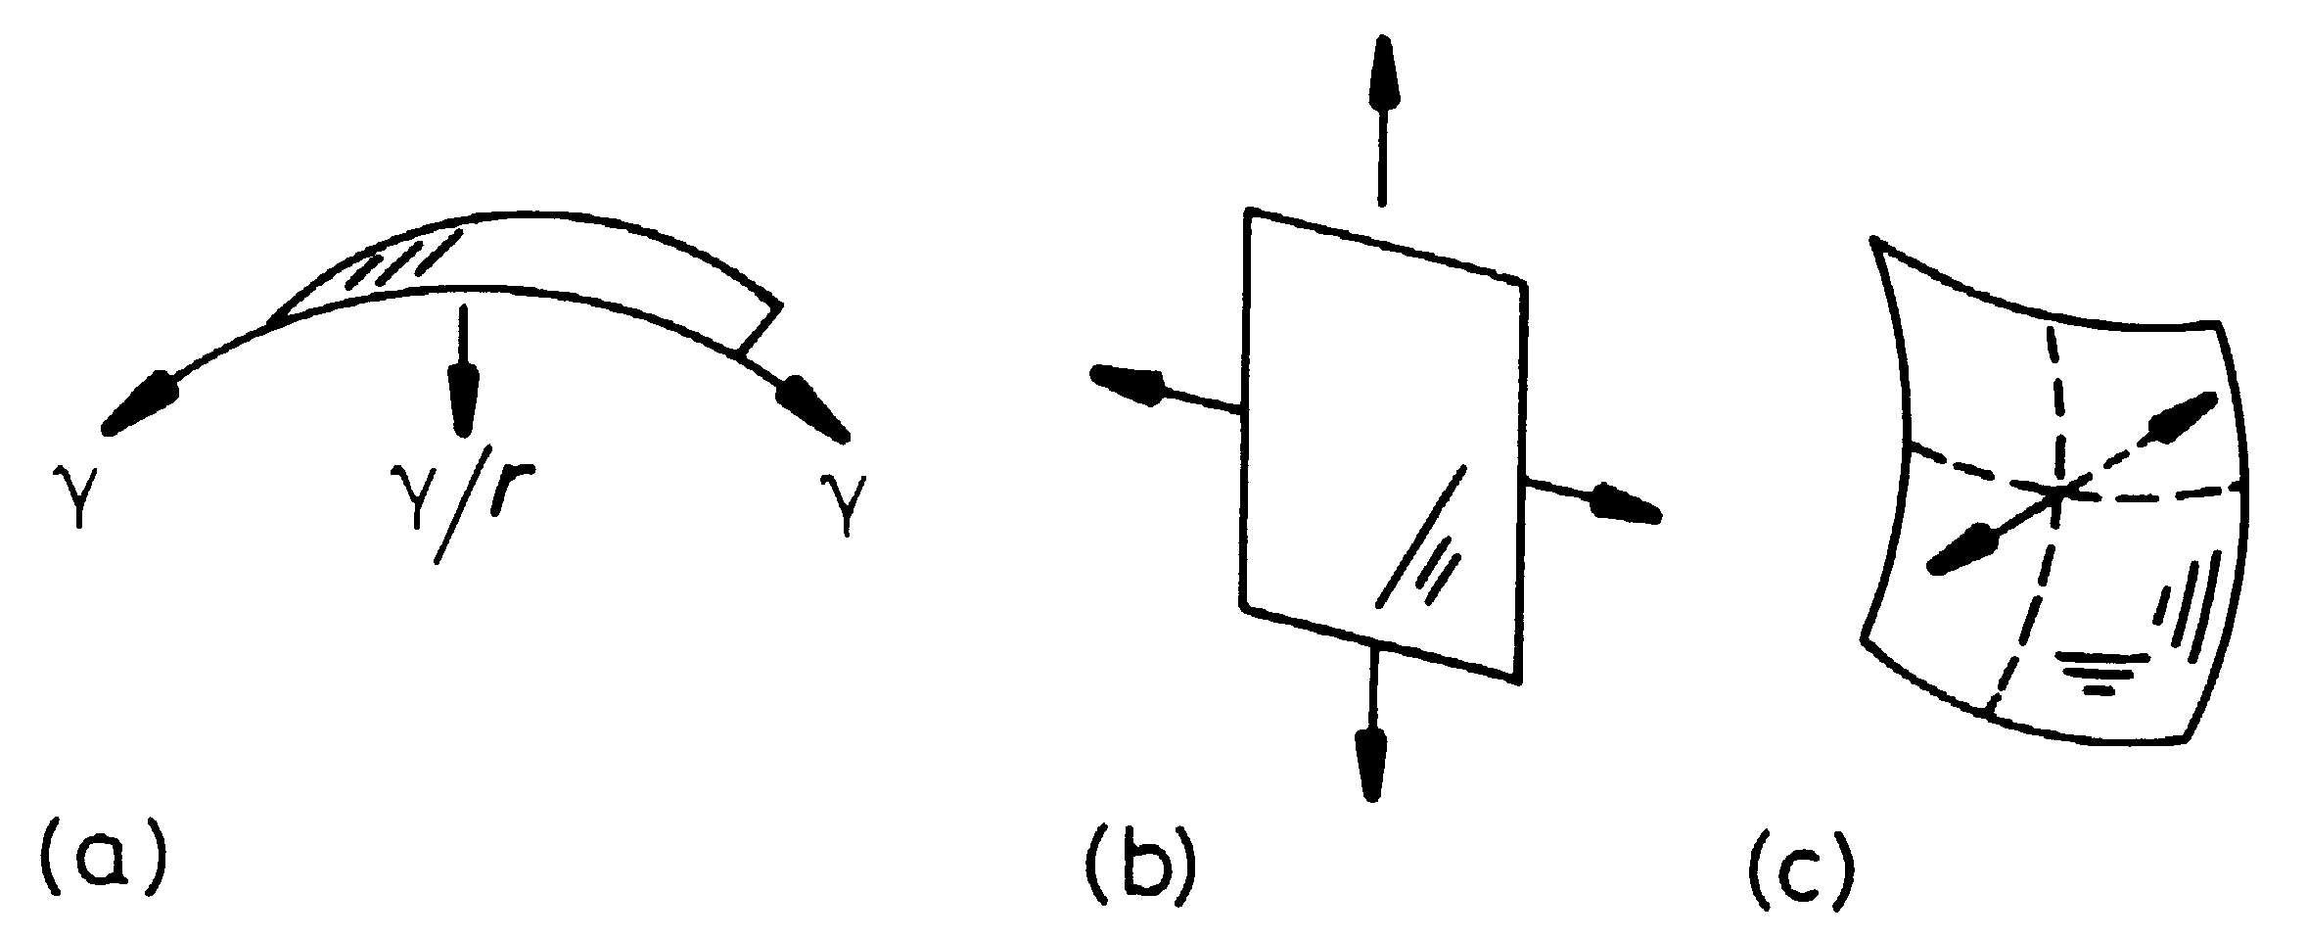
Sign of Curvature
Porter & Easterling, fig. 3.20, p130
(a) singly curved; (b) zero curvature, zero force; (c) equal principal curvatures, opposite signs, zero (net) force.

Slide 35
Questions (1)
What is the relationship between interfacial energies and contact angle, e.g. for droplets of liquid on a solid surface?
Why do grain boundaries develop surface grooves if the material is annealed at sufficiently high temperature?
What is the “n-6 rule”? Under what circumstances is it valid?
What terms enter the equation for the migration rate (velocity) of a grain boundary?

Slide 36
Questions (2)
What do you obtain by integrating the rate of change of the tangent to the grain boundary around the perimeter of a grain?
What does a triple point do to the tangent (or turning angle)?
What can one say about the expected growth rate of grains with less than or greater than 6 sides?
What is observed experimentally about the relationship between growth/shrinkage rate and topological class (i.e. number of sides)?

Slide 37
Questions (3)
What is the self-similarity principle in grain growth?
What simple derivation due to Burke shows that the average radius is expected to vary as √(time)?
Is the square root dependence actually observed?
What is the most basic grain growth theory that describes kinetics and predicts the grain size distribution?

Slide 38
Questions (4)
What grain size distributions are actually observed experimentally (and in simulations)?
What is the full description of the migration rate of grain boundaries?

Slide 39
Summary (1)
Force balance at triple junctions leads to the Herring equations. These include both surface tension and torque terms.
If the interfacial energy does not depend on inclination, the torque terms are zero and Herring equations reduce to the Young equations, also known as the sine law.
In 2D, the curvature of a grain boundary can be integrated to obtain the ‘n-6’ rule that predicts the growth (shrinkage) of a grain.
Normal grain growth is associated with self-similarity of the evolving structures which in turn requires the area to be linear in time.
Hillert extended particle coarsening theory to predict a stable grain size distribution and coarsening rate.

Slide 40
Summary (2)
The capillarity vector allows the force balance at a triple junction to be expressed more compactly and elegantly.
It is important to remember that the Herring equations become inequalities if the inclination dependence (torque terms) are too strong.

Slide 41
Application to G.B. Properties
In principle, one can measure many different triple junctions to characterize crystallography, dihedral angles and curvature.
From these measurements one can extract the relative properties of the grain boundaries.
The method for extracting relative GB energy was described in the lecture notes on that topic (L15 in 2014).

Slide 42
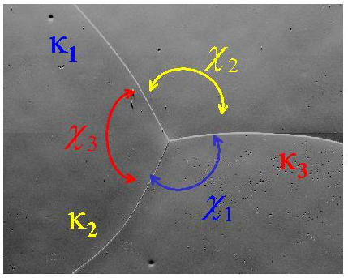
Energy Extraction
(sinχ₂) σ₁ - (sinχ₁) σ₂ = 0
(sinχ₃) σ₂ - (sinχ₂) σ₃ = 0
σ₁
σ₂
σ₃
:
σ_{n}
sinχ₂ -sinχ₁ 0 0 …0
0 sinχ₃ -sinχ₂ 0 ...0
* * 0 0 ...0
: : : : :
0 0 * * 0
= 0
Measurements at many TJs; bin the dihedral angles by g.b. type; average the sinχ; each TJ gives a pair of equations
D. Kinderlehrer, et al. , Proc. of the Twelfth International Conference on Textures of Materials, Montréal, Canada, (1999) 1643.

Slide 43
Mobility Extraction
(σ₁κ₁sinχ₁)m₁ + (σ₂κ₂sinχ₂)m₂ + (σ₃κ₃sinχ₃)m₃ = 0
m₁
m₂
m₃
:
m_{n}
σ₁κ₁sinχ₁ σ₂κ₂sinχ₂ σ₃κ₃sinχ₃ 0 0 …0
0 * * * 0 ...0
* 0 * * 0 ...0
: : : : : :
0 0 * * * 0
= 0

Slide 44
Example of importance of interface stiffness
The Monte Carlo model is commonly used for simulating grain growth and recrystallization.
It is based on a discrete lattice of points in which a boundary is the dividing line between points of differing orientation. In effect, boundary energy is a broken bond model.
This means that certain orientations (inclinations) of boundaries will have low energies because fewer broken bonds per unit length are needed.
This has been analyzed by Karma, Srolovitz and others.

Slide 45
Broken bond model, 2D
[10]
We can estimate the boundary energy by counting the lengths of steps and ledges.

Slide 46
Interface stiffness
At the singular point, the second derivative goes strongly positive, thereby compensating for the low density of defects at that orientation that otherwise controls the mobility!

